Slide 1


Slide 2
Chapter 1
Four Rules for Data Success

Slide 3
Big Deal?
Question:
When did data become a big deal?
Answer:
When it became extremely accessible.

Slide 4
Data and the Single Server
When and why did the single “server” become and endangered species?

Slide 5


The Big Data Trade Off
Single machine extinct.
Distributed computing storms in.

Slide 6
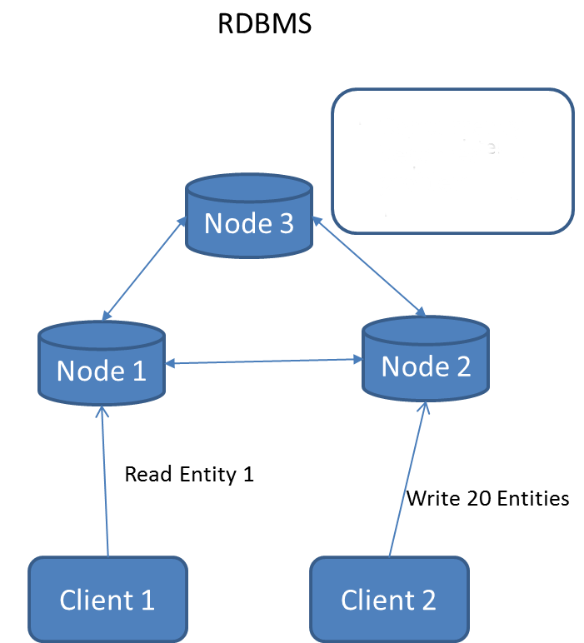
The Big Data Trade Off
RDBMS

Slide 7
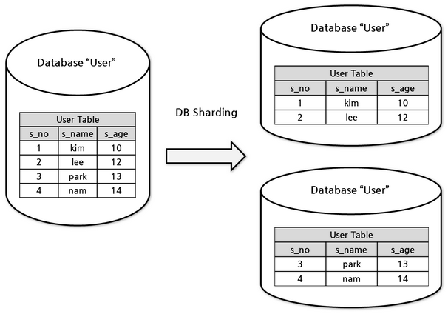
The Big Data Trade Off
RDBMS - Sharding

Slide 8
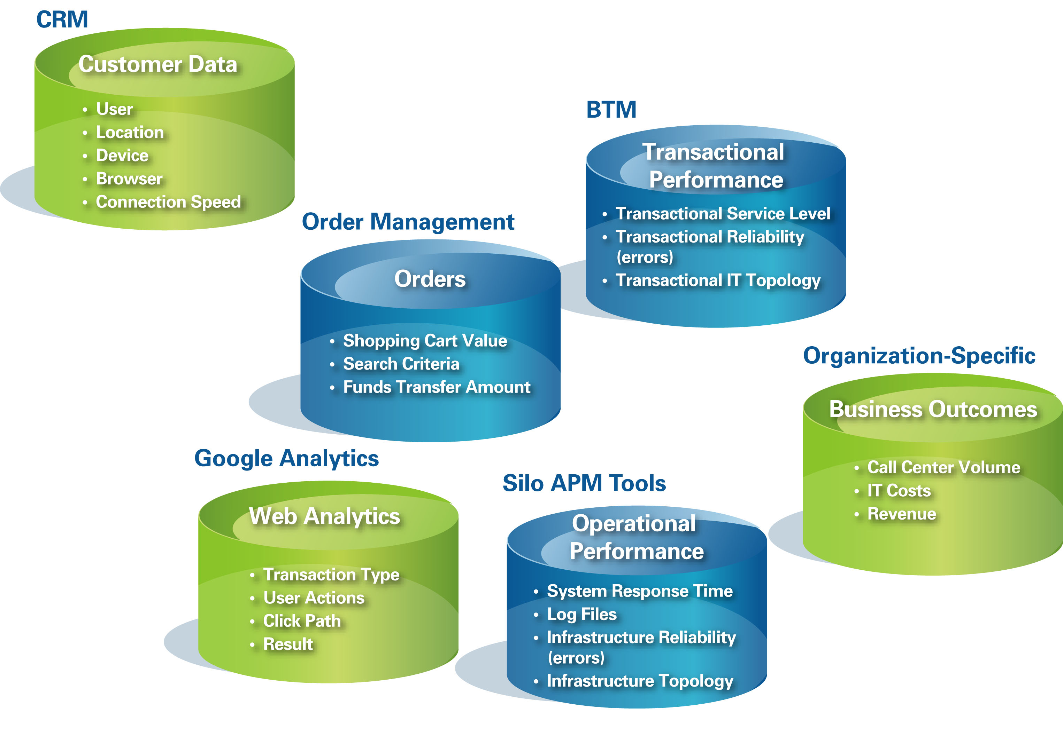
The Big Data Trade Off
Silos

Slide 9
Four Rules for Data Success
Build Solutions That Scale (Toward Infinity)
Build Systems That Can Share Data (On the Internet)
Build Solutions, Not Infrastructure
Focus on Unlocking Value from Your Data

Slide 10
Build Solutions That Scale (Toward Infinity)
Sharding or Partitioning RDBMS is ok … sometimes.
Using different storage paradigms for different types of data (Silos) is ok … sometimes.
When and how do you choose or switch solutions?
“Throwing hardware at the problem will help, but eventually the database server itself becomes the bottleneck.[1]”
1. http://www.scalebase.com/tag/mysql-scalability-issues/

Slide 11
Build Systems That Can Share Data (On the Internet)
Data must be stored so it’s:
Accessible
Scalable
Old Mentality
data warehouse solution
New Mentality
Keep data in whatever silo is the best fit and build tools that can glue different systems together.
Result
Focus on keeping data where it works best
find ways to share and process it when the need arises

Slide 12
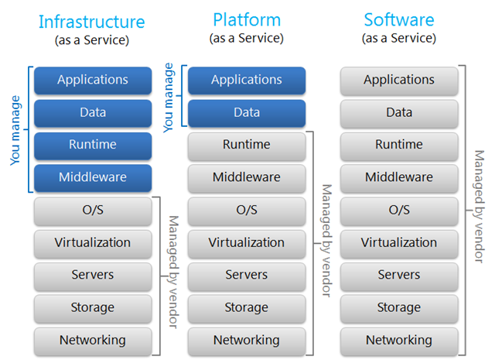
Build Solutions, Not Infrastructure
IAAS PAAS SAAS

Slide 13

Build Solutions, Not Infrastructure
“buying and building applications hosted ‘in the cloud’ should be considered the rule, not the exception.”

Slide 14

Build Solutions, Not Infrastructure
Collecting massive amounts of data in itself doesn’t provide any magic value to a business or organization.
The real value in data comes from your ability to make sense of it all.

Slide 15
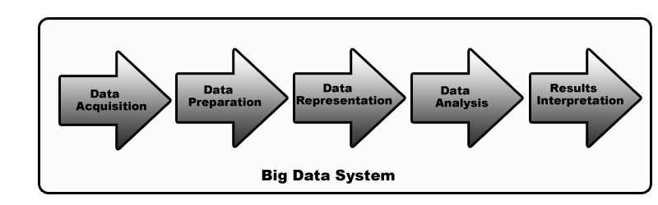
Big Data Pipeline

Slide 16
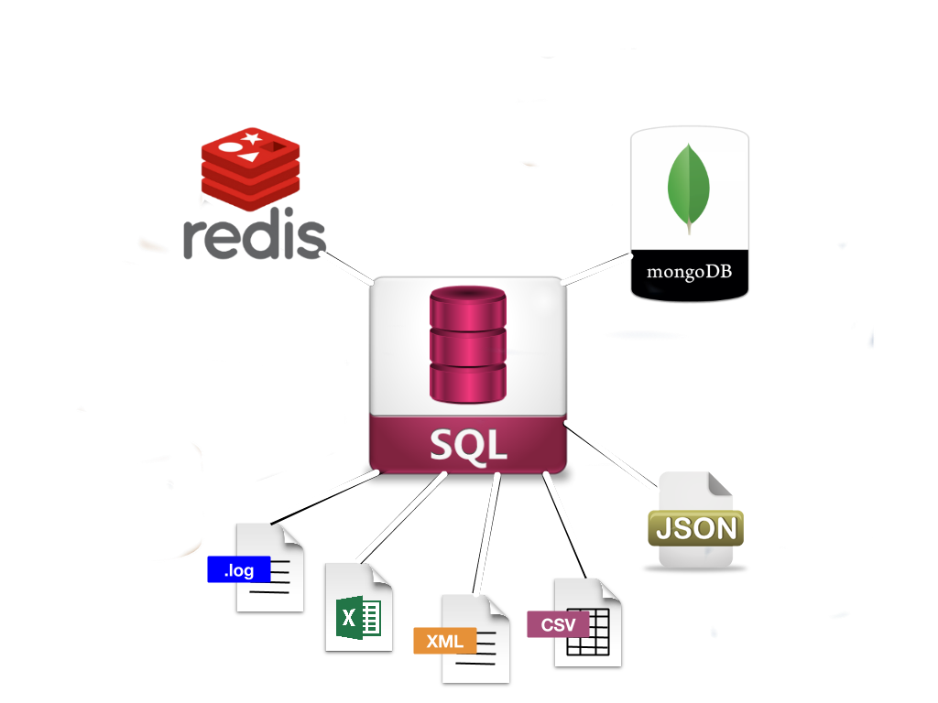
Perfect Database

